Slide 1

The Quest for city in US
Balaji B C

Slide 2
Index
Introduction
Data Description
Exploratory Data Analysis
Modelling
Conclusion

Slide 3
Introduction
Background:
A reputed restaurant chain is planning to expand their business in United states
Business goals:
To find possibly the most suitable city to open a restaurant in united states
Find the restaurant type most preferred by the country people

Slide 4
Data collection and wrangling
Details of largest population cities in United States by 2020 WorldPopulationReview
Top 50 largest cities have been considered for this project
City latitude and longitude information is needed from Google maps links provided in WorldPopulationReview
The largest populated city in US is ‘New York’ with 8.1 million
The least populated cities in our dataset is ‘Miami’ with 0.4 million population
In total, 50 rows and 5 features in the raw dataset

Slide 5
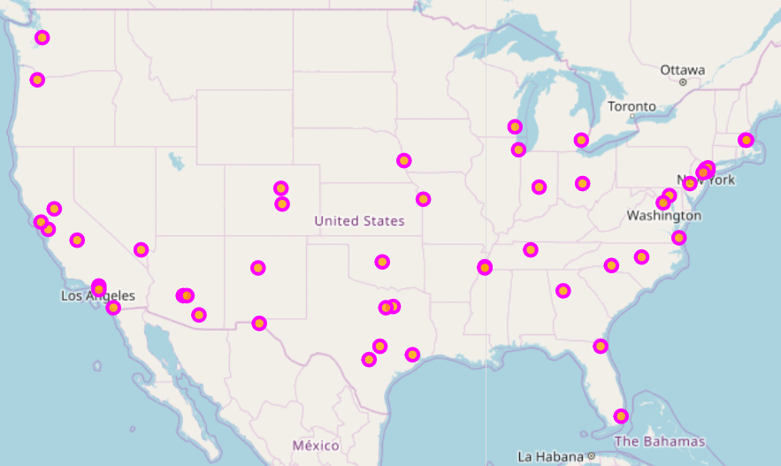
Data visualization (Before clustering)
50 largest cities in US

Slide 6
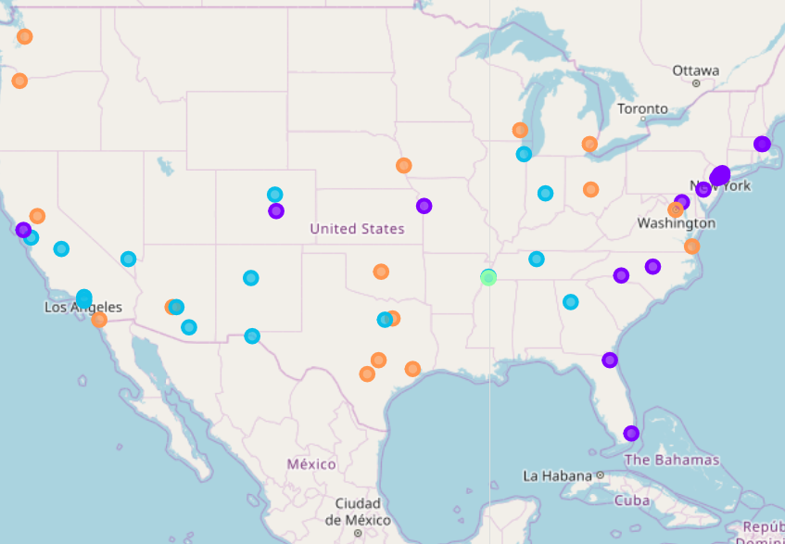
Model - Data visualization (After clustering)
Divided into 4 groups
One city in green spotted with not much similarities
New South Memphis, Cluster 3

Slide 7
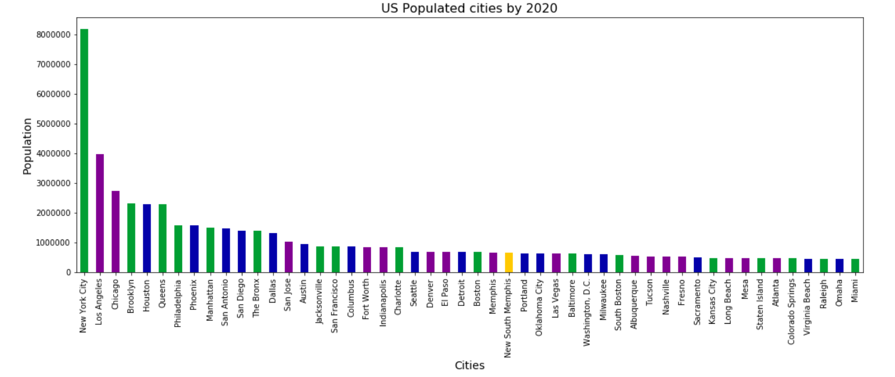
28th Ranked city- ‘New South Memphis’ population is 641,608
Less number of restaurants in two miles radius (only 2)
Only Chinese and Fast food restaurants

Slide 8
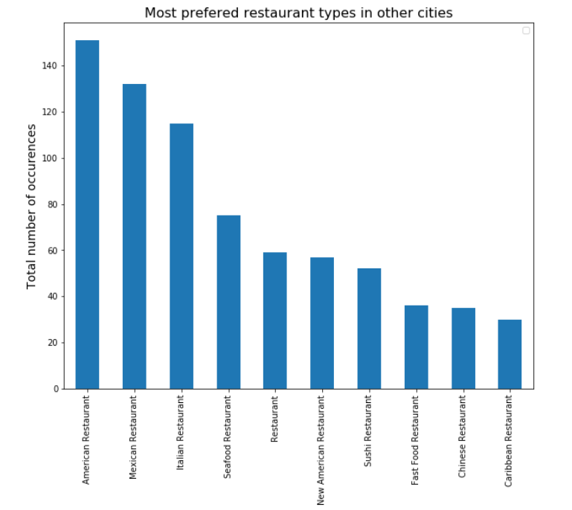
Restaurants types doing well in other cities across US
American, Mexican & Italian restaurants being top 3
None of top 10 restaurants present in city – “New South Memphis”

Slide 9
Conclusion
The US City suitable for investors to open a restaurant within 2 miles from city center is "New South Memphis“
Since it has only two types of restaurants, Investors can select any of the top restaurants preferred by country people
Investors may also consider other own business factors such as Type of restaurant with descent investment and high returns.

